Slide 1
Scottish Terrier Club Of Chicago
Showing the Scottish Terrier
A Breeder’s Perspective
April 19, 2015
Richard C. Bumstead, Kathy Hufnagel. Steve Russell, Sue Severtsen

Slide 2
Introduction
Richard C. Bumstead
Showing the Scottish Terrier
Notes:
Thank you –
Kim Woods approached me last summer after the Specialty to ask if I could pull together a presentation on showing the Scottish Terrier from a Breeders perspective to help inform and educate the club members
Thought this was a great opportunity to share some perspective on the sport
Those of us here today represent over 100 years experience in the sport of dog shows
We are a dying breed- not many behind us to fill the shoes – especially in Terriers
But we still fill an important role in breed fancy, as do all the regional and parent clubs for all the AKC recognized breed- a core group dedicated to maintaining the Scottish Terrier
We do this by showing and breeding our best dogs
One of the best opportunities to do this is at club Specialties – brings the largest entries and exhibitors equally dedicated to the breed
The STCC, as stated in its Constitution, Is fulfilling one of the primary reasons for and purposes of the club by hosting its annual specialty.

Slide 3
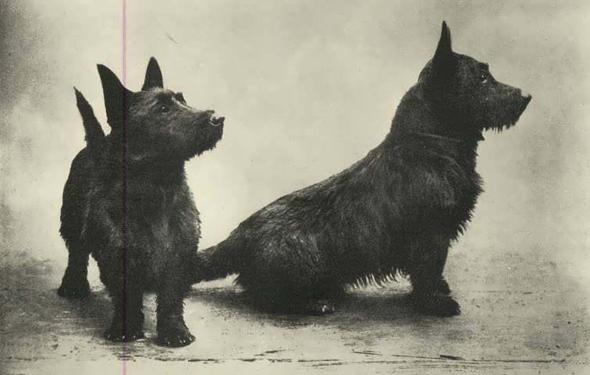
The Beginning….
Showing the Scottish Terrier
Notes:
This is where the breed came from – a pair of well know Scottish Terriers who were sweeping up the ribbons in England about 1895 – a father and son, who sired many champions during their time.
Not long after the breed was distinguished from the other Highland breeds
Of course today any judge would dismiss them for lack of merit.
But the goal of the dog show remains the same today as it did back when the AKC was founded in 1884: To select the best breeding stock to to perpetuate the breed and bring it towards perfection.

Slide 4
The Dog Show
Richard C. Bumstead
Showing the Scottish Terrier
Notes:
So, how does this happen?
Each of us will take a few minutes to talk about different aspects of the show and how they take place, what happens in the ring and why, and then answer a few questions that Kim felt would be good to get the conversation going.

Slide 5
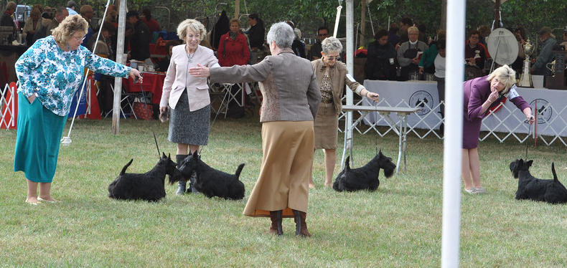
Sponsors, Organization, and Management
Kennel Clubs, Breed Clubs, and dog shows
The Superintendent
The Judge and Steward
Showing the Scottish Terrier
Notes:
The AKC supports local dog clubs which host a wide variety of events for dogs. We will focus only on what is call conformation – examining the physical characteristics of the breed.
The dog clubs can be all breed clubs, Group Clubs, or Breed Clubs, and their primary purpose – according to AKC is to host dog shows. For instance during our show weekend there are three different clubs which paly a role in the show:
Little Fort Kennel Club
GLATA
STCC
The next major player is called the Superintendent. They carry the weight of organizing the show :
Distribute the Premium list
Collect entries and fees and
Put together the judging program for the day of the show
Set up the show site with rings, tables, mats, fencing, etc
Order ribbons, distribute prize money, keep records, send results to AKC
The judge is an individual that has been involved in dogs for years, passed written and oral tests to become well versed in the nuances of each breed they judge.
The steward runs the ring for the judge, so that the judge can concentrate solely on the dogs

Slide 6
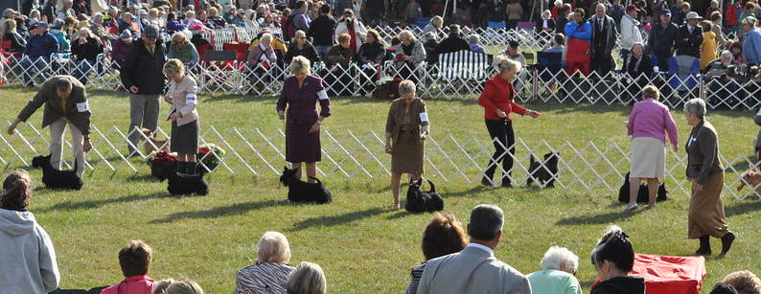
Dog Show Classes
Specialties, Group Shows, and All Breed Shows
Sweepstakes
Regular classes
Non Regular classes
Best of Breed Ring
AKC Groups
Showing the Scottish Terrier
Notes:
As there are a variety of kennel clubs, there are also a variety of dog shows:\
All breed – all eligible AKC breeds can enter (Little Fort)
Group shows – limited to all breeds within a Group (GLATA)
Specialties – limited to a single breed
Sweepstakes are for young dogs, most often associated with Specialties, but can also be part of an all breed show. Practice for judges and dogs
Under 18 month of age
Often restrictions on what the entry has won already
No points towards AKC Championship
Regular Classes
Always divided by Sex
6-9.9-12, 12-18, Novice, American bred, Bred By, Open
Each class winner then competes for Winners/Reserve
Non-Regular Classes
Always divided by Sex
Veterans, Stud Dog, Brood Bitch, Brace,
Best Of Breed Ring
Any dog with an AKC CH title is allowed to enter
WD and WB are also brought into the ring : Veterans also brought in
BOB,BW, BOS, SD, SB, and at Specialties AOMs
BOH is then judged
In a Group Show just the breeds compete, In al All bred, all breed winners compete for Group Wins, and then BIS, RBIS

Slide 7
.
The STCA Standard
Sue Severstson & Kathy Hufnagel
Showing the Scottish Terrier

Slide 8
.
What’s the Judge doing?
Steve Russell
Showing the Scottish Terrier

Slide 9
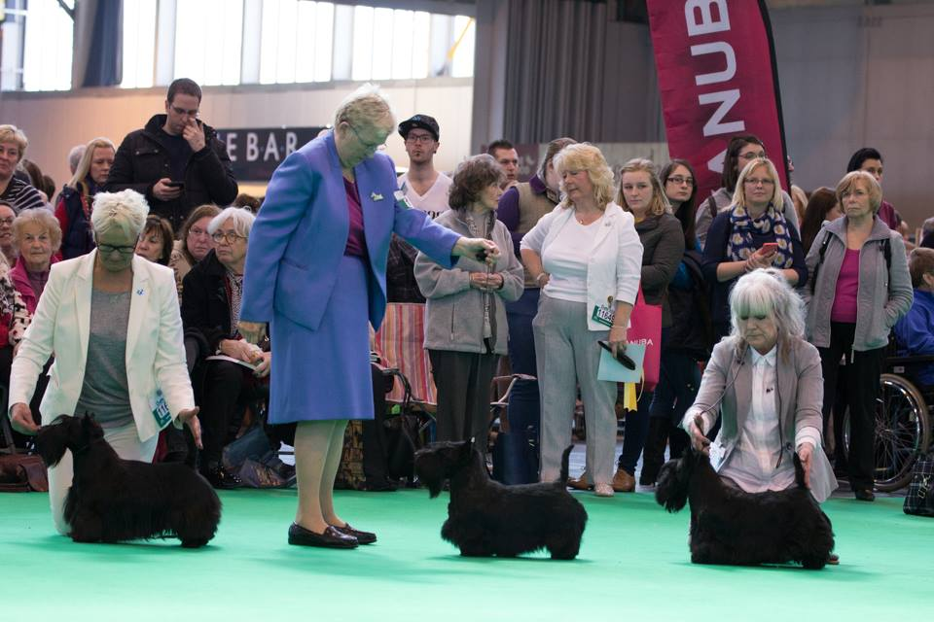
Entrance - Examine Lineup
Assess general appearance. Note size and proportion. Stand back and take a side view for length of back, topline, and balance. Look for a pronounced hindquarters and forechest.
Showing the Scottish Terrier

Slide 10
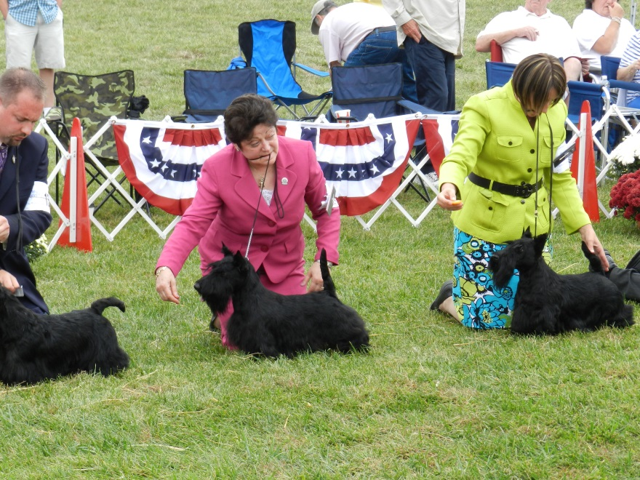
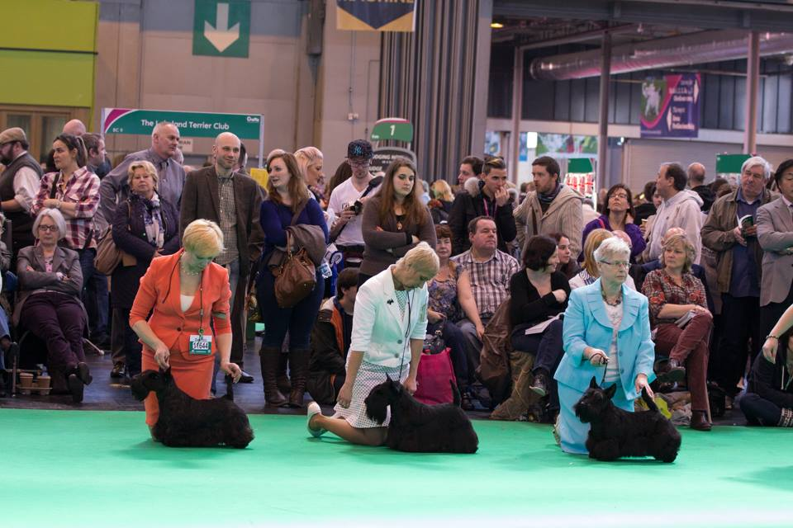
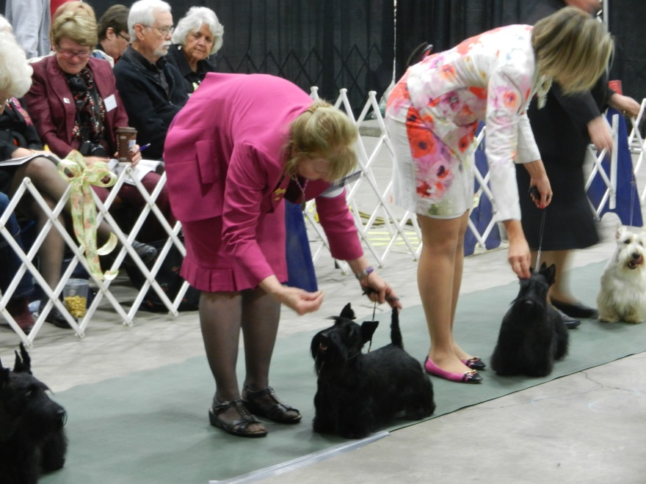
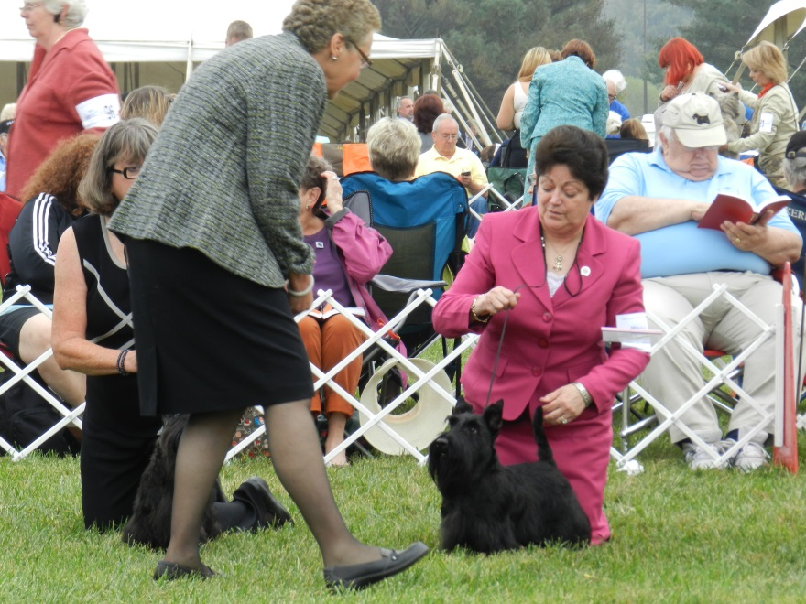
The Line-up
Showing the Scottish Terrier

Slide 11
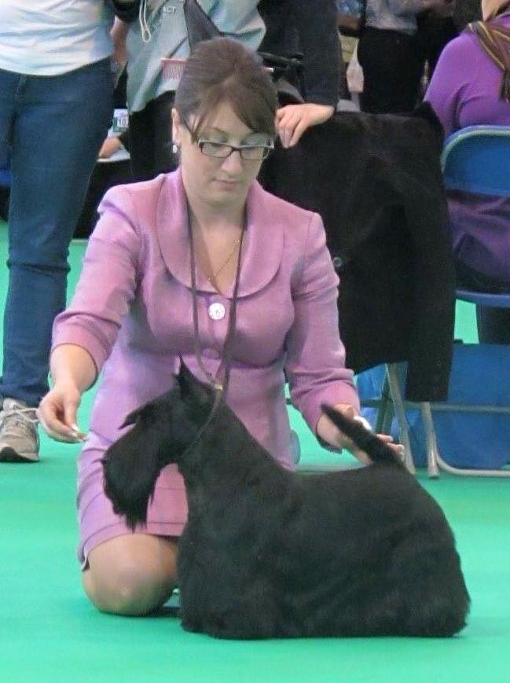
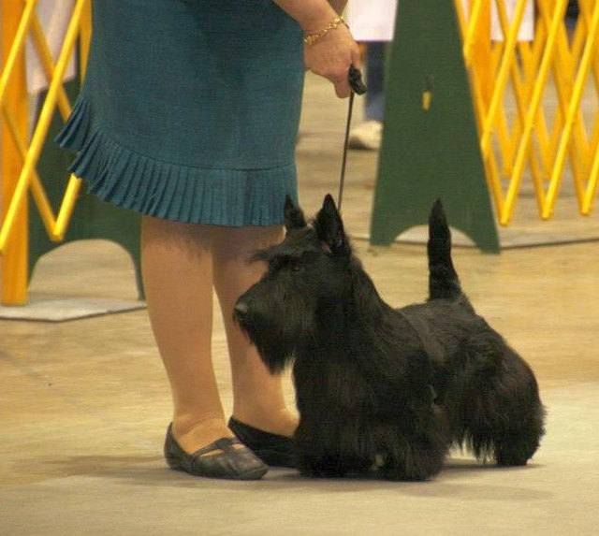
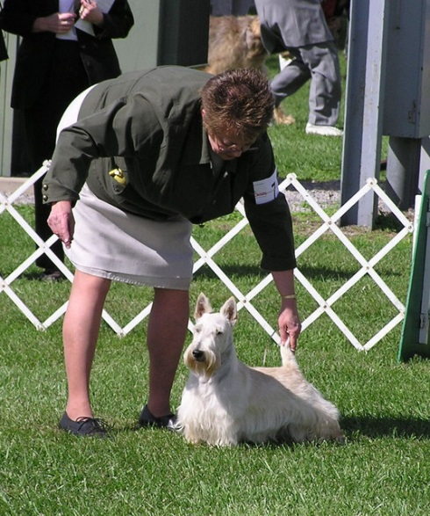
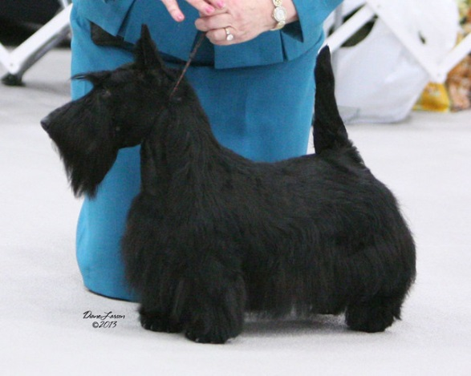
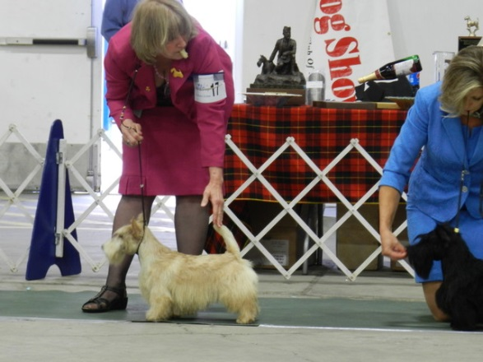
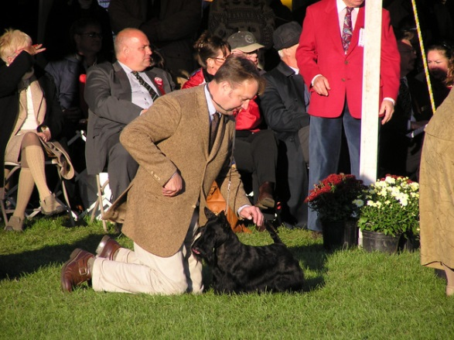
Stacking
Showing the Scottish Terrier

Slide 12
Table Examination
Upon examination on the table to confirm that your observations were real and not masterful grooming.
Showing the Scottish Terrier

Slide 13
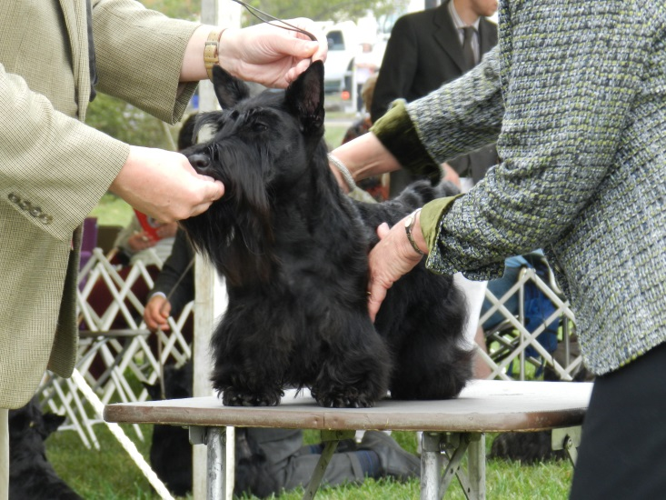
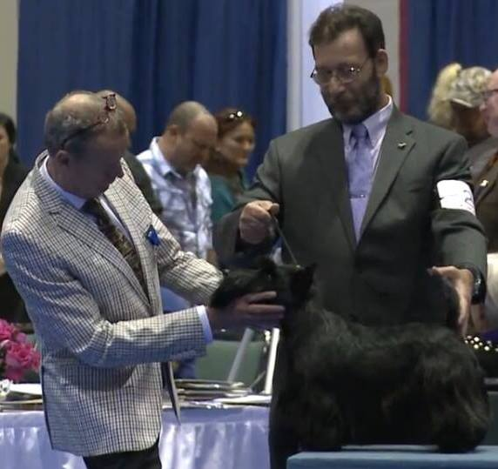
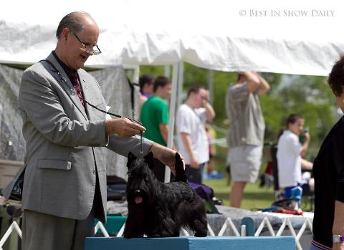
Table Examination (cont’d)
Showing the Scottish Terrier

Slide 14
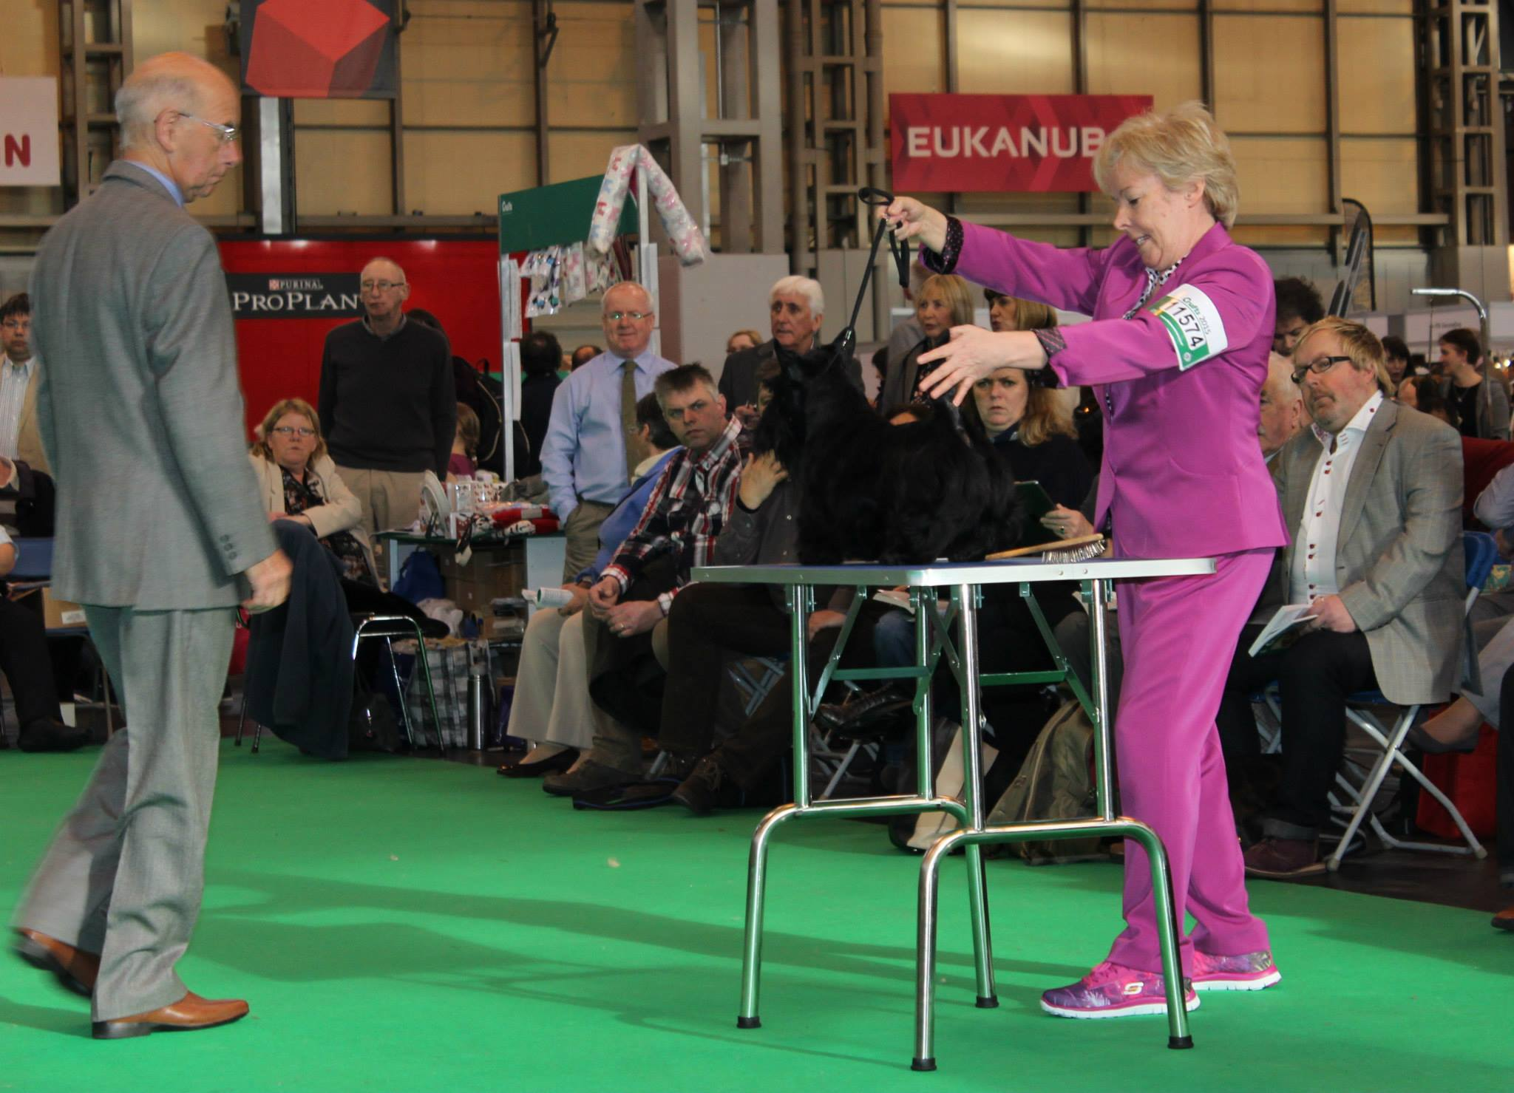
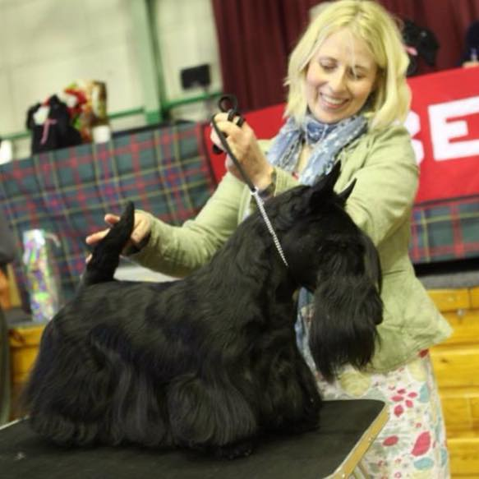
Table Examination (cont’d)
Showing the Scottish Terrier

Slide 15
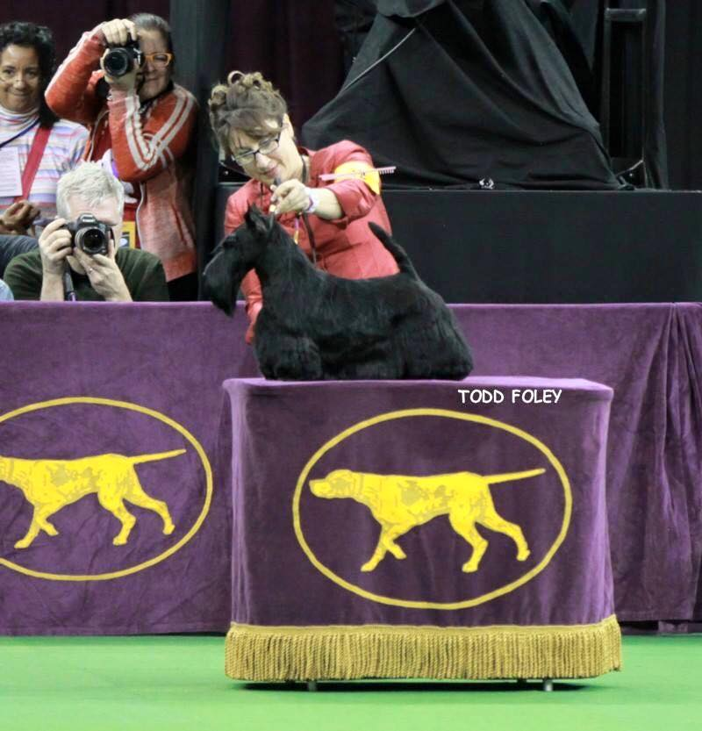
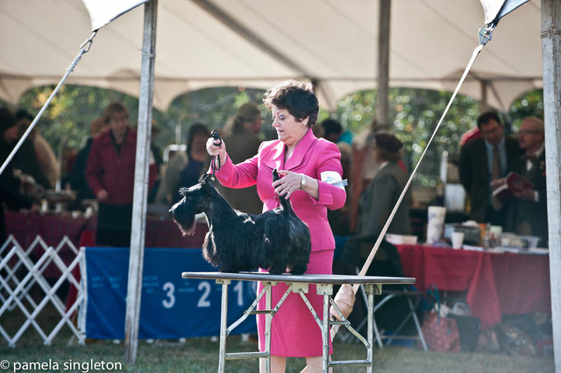
Table Examination (cont’d)
Showing the Scottish Terrier

Slide 16
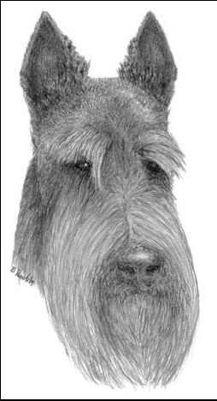
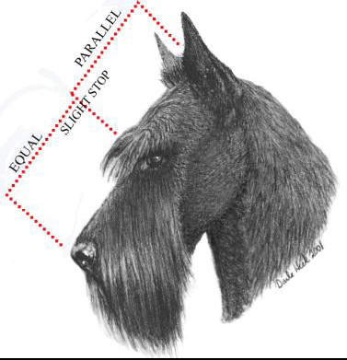
Head Examination
Long head in proportion to the size of dog, skull medium width, good fill under eye, good strength of muzzle with sizeable teeth.
Showing the Scottish Terrier

Slide 17
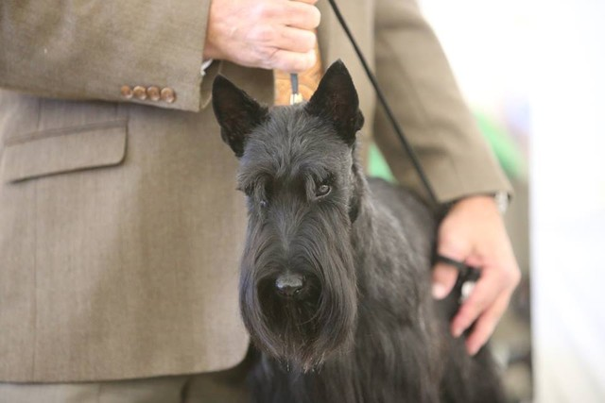
Head Examination
Showing the Scottish Terrier

Slide 18
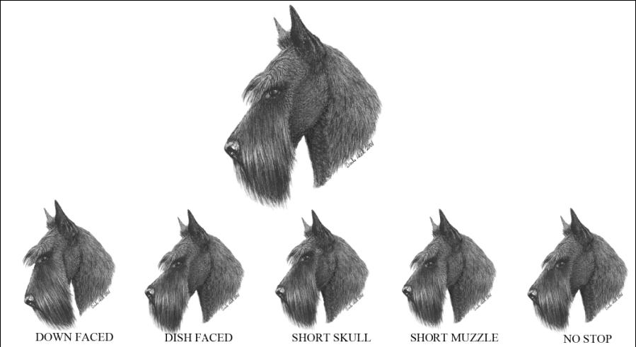
Head Profile
Showing the Scottish Terrier

Slide 19
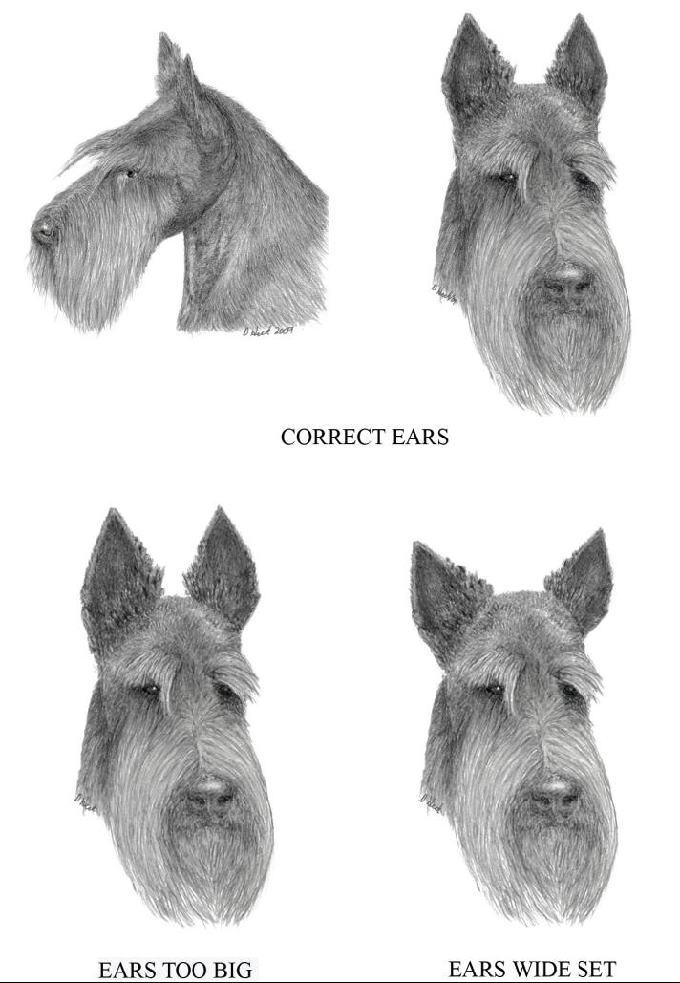
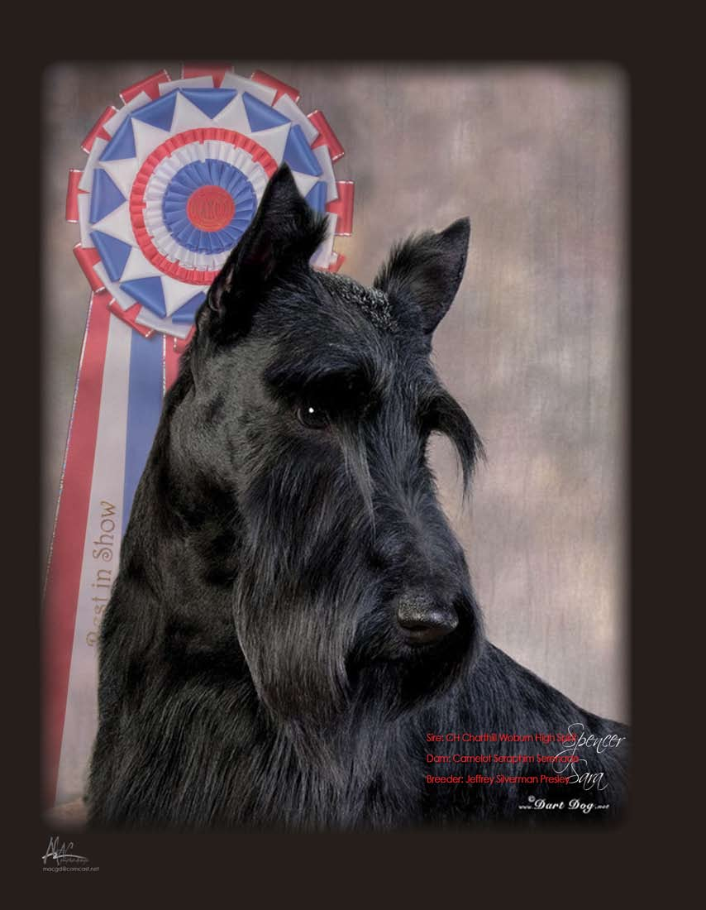
Head and Ears
Showing the Scottish Terrier

Slide 20
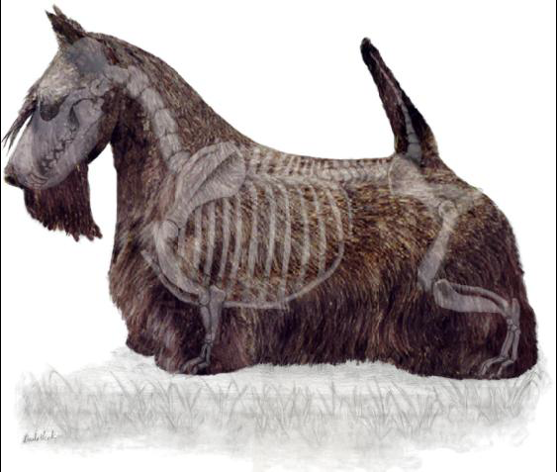
Body Examination
Low to ground. Deep brisket ending below the elbow. Compact from withers to tail; however, longer from point of chest to point of rump. Obvious forechest and obvious rear shelf add to length. Heavy bone and substance for the size of the dog.
Showing the Scottish Terrier

Slide 21
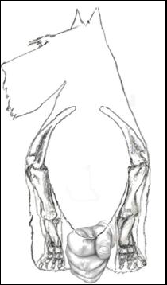
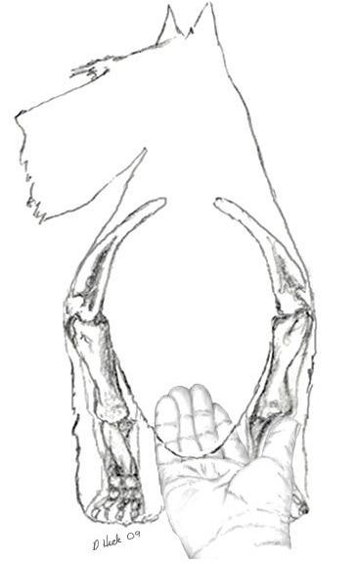
Chest
Heavy Bone
Powerful Muscle
Deep Ribs
Short, Broad Loin
Deep Brisket
Showing the Scottish Terrier

Slide 22
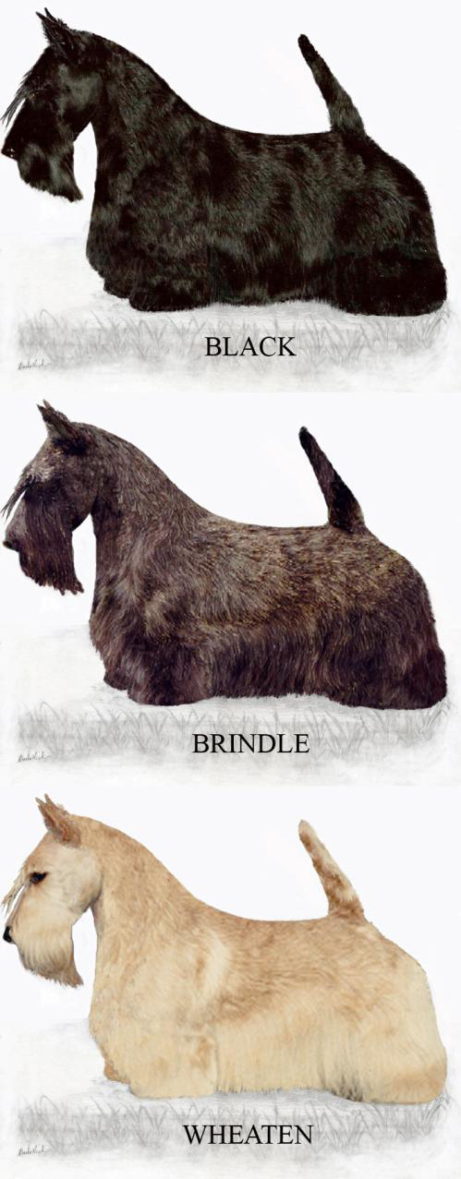
Coat
All colors are equally desirable and judged to the same standard.
Harsh wiry outer coat and soft dense undercoat to protect dog from injury and inclement weather.
Regardless of coat color, Scotties must have black nose, eye rims, and dark eyes.
Showing the Scottish Terrier

Slide 23
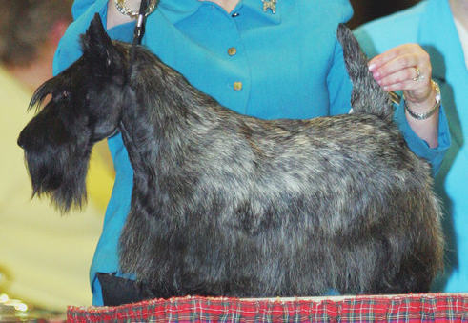
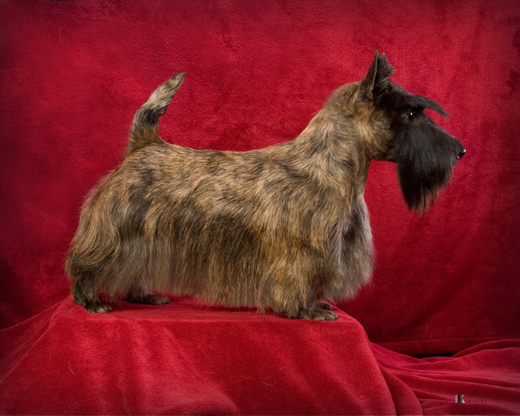
Coat Color
Showing the Scottish Terrier

Slide 24
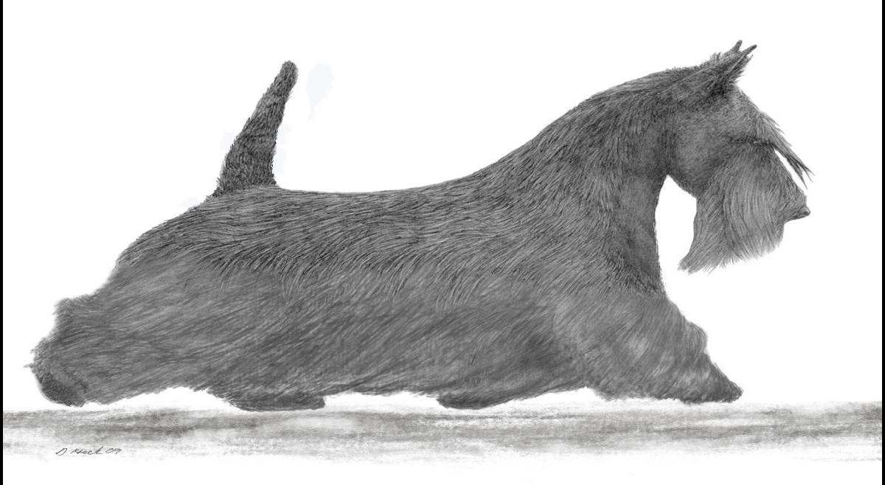
Movement
Gait is unique to the breed with forelegs that incline slightly on acceleration while rear legs move true. A correctly built Scottie should cover ground well despite his short legs.
Showing the Scottish Terrier

Slide 25
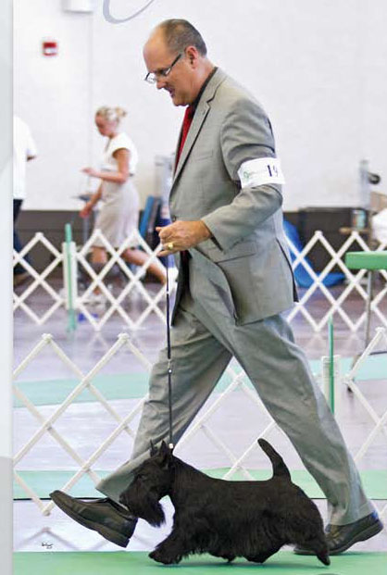
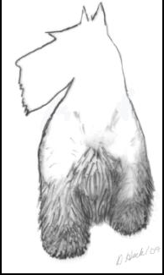
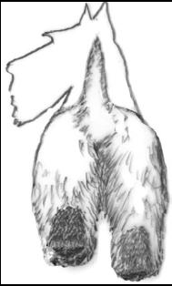
Gait
From the front
From the rear
Showing the Scottish Terrier

Slide 26
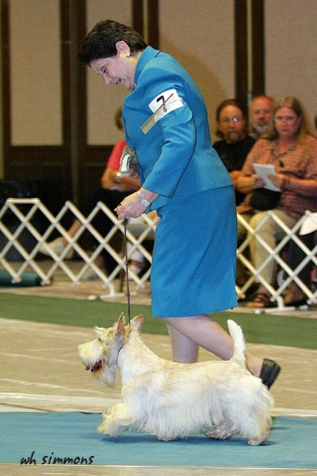
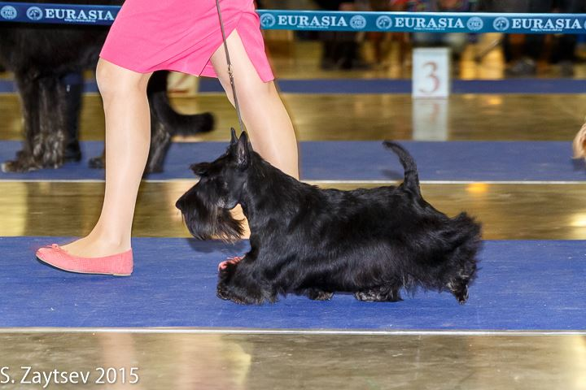
Gait (cont’d)
Showing the Scottish Terrier

Slide 27
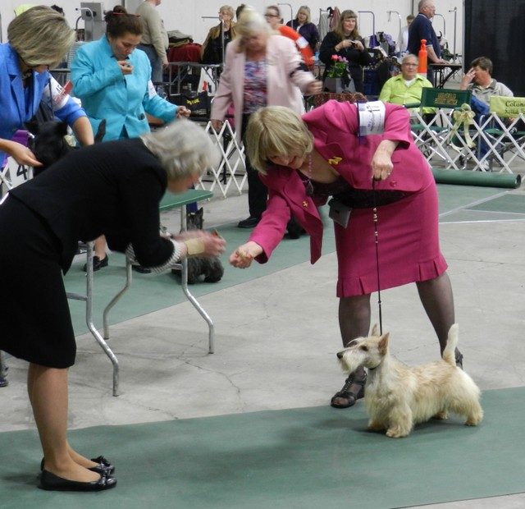
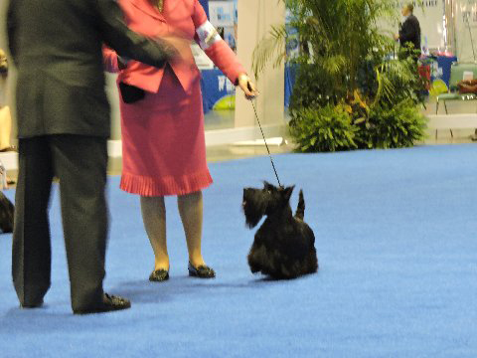
Expression
Showing the Scottish Terrier

Slide 28
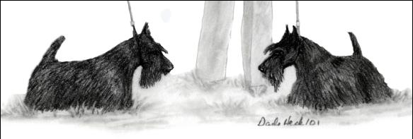
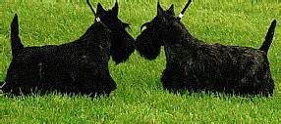
Sparring
Purpose of Sparring is to see real terrier character and which is confident and dignified attitude with no sign of shyness or timidity.
Showing the Scottish Terrier

Slide 29
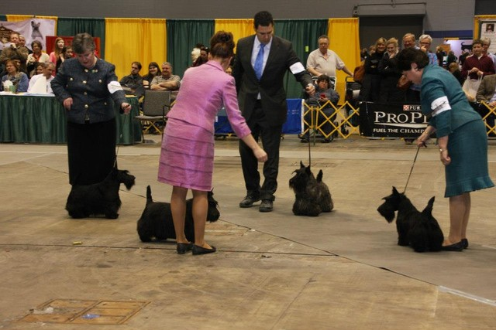
Sparring (cont’d)
Showing the Scottish Terrier

Slide 30
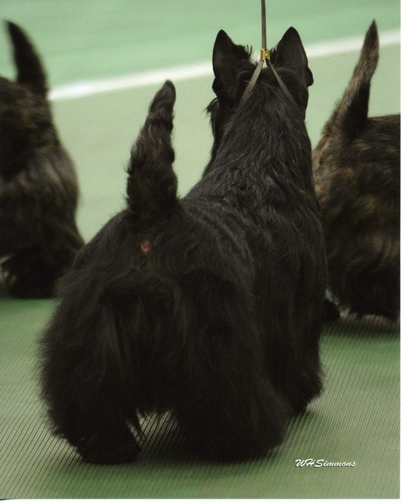
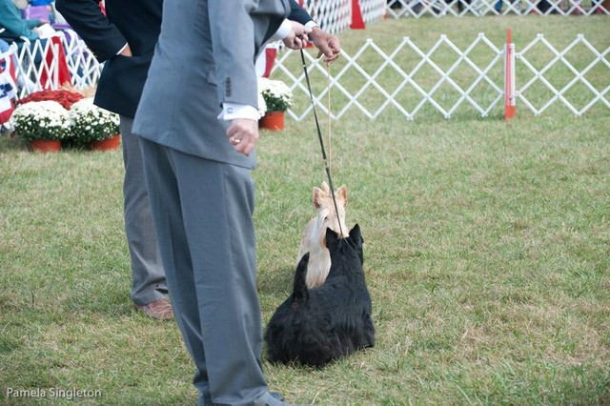
Sparring (cont’d)
Showing the Scottish Terrier

Slide 31
Judging Review
Key Elements of Scottish Terrier Type
Temperament
Low to Ground
Heavy Bone and Substance
Long Head
Harsh Outer Coat & Dense Undercoat
Movement Gait Unique to Breed
Showing the Scottish Terrier

Slide 32
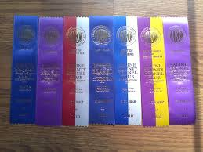
Judges Placements
Ribbons
Classes –
1st, 2nd, 3rd, 4th
Breed –
BOB, BOW, BOS, SD, SB, AOMs
Showing the Scottish Terrier

Slide 33
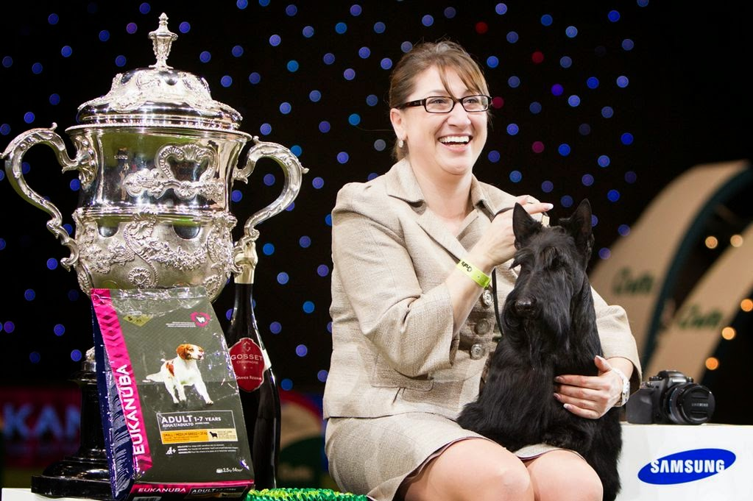
Best in Show – Crufts 2015
GCH McVan’s To Russia with Love with Rebecca Cross
Showing the Scottish Terrier

Slide 34
The Use of a Professional Handler
Sue Severtson & Kathy Hufnagel
Showing the Scottish Terrier

Slide 35
Roundtable Question #1
From a Breeders Point of View, why are you showing, and what impact do shows have on your breeding program.
Russell
Hufnagel
Bumstead
Severston
Showing the Scottish Terrier

Slide 36
Roundtable Question #2
Why should the STCC Specialty be important to the Scottish Terrier Companion Owners?
Severtson
Bumstead
Russell
Hufnagel
Showing the Scottish Terrier

Slide 37
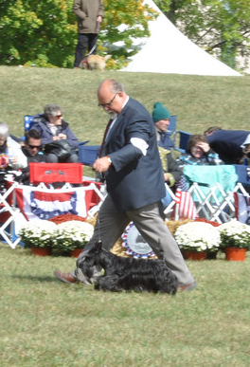
.
QUESTIONS?
Showing the Scottish Terrier

Slide 38
THANK YOU!
Steve, Kathy, Sue, and Richard
Showing the Scottish Terrier

Slide 39
STCA Standard’s Outline
TOPICS COVERED
General Appearance
Size, Proportion, Substance
Head
Neck, Topline, Body
Forequarters
Hindquarters
Coat
Color
Gait
Temperament
Penalties
SCALE OF POINTS
Skull 5 Muzzle 5 Eyes 5 Ears 10 Neck 5 Chest 5 Body 15 Legs and Feet 10
Tail 5
Coat 15 Size 10 General Appearance 10 Total 100
Showing the Scottish Terrier

